Slide 1
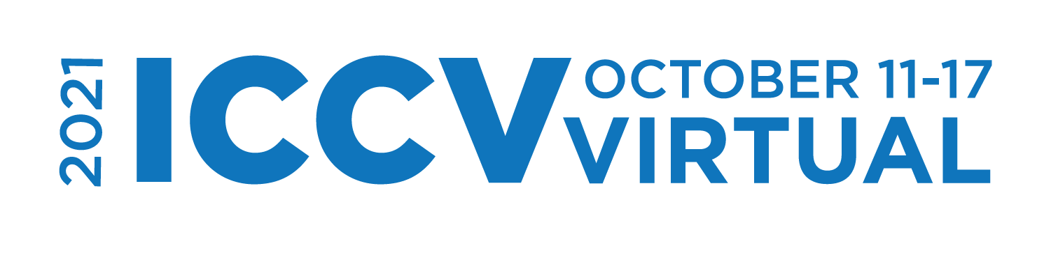


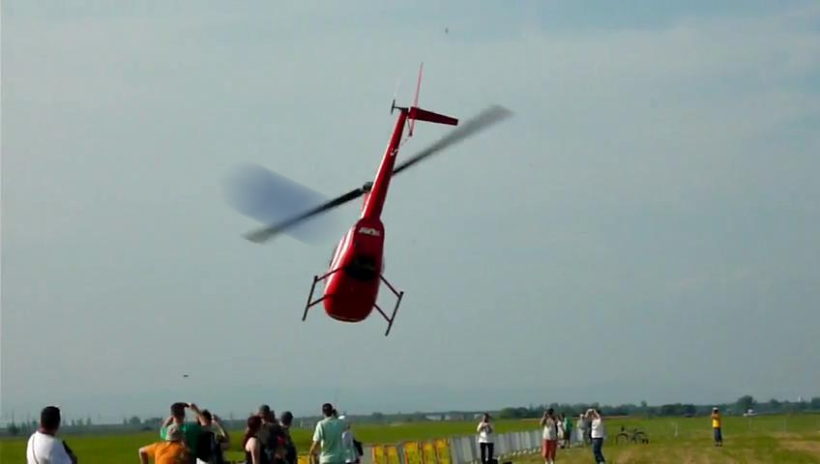
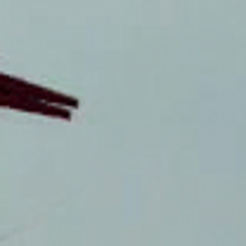
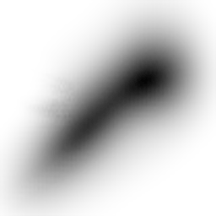
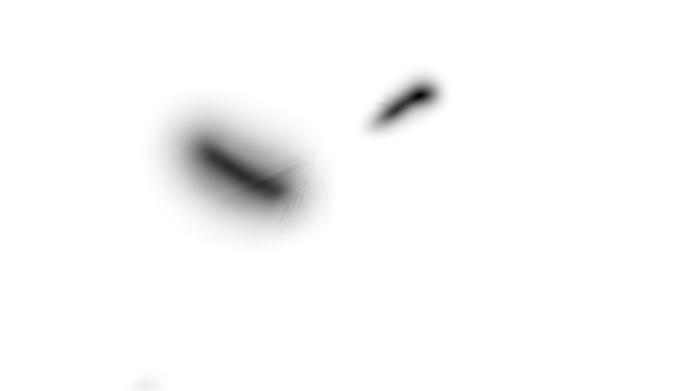
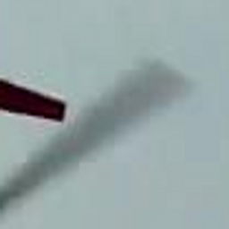
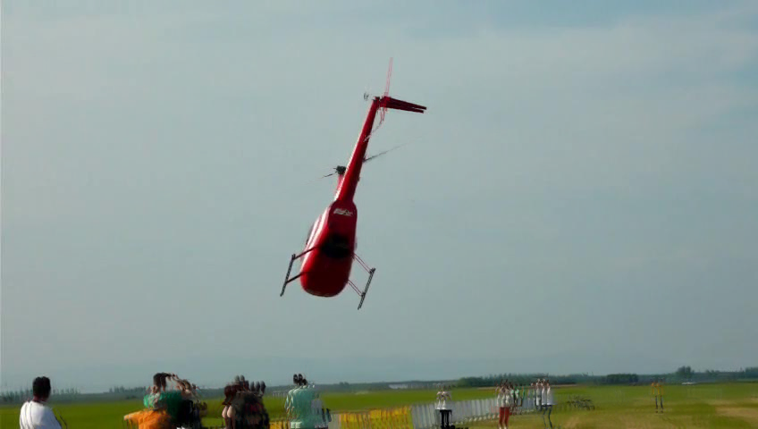
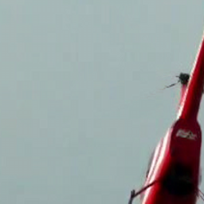
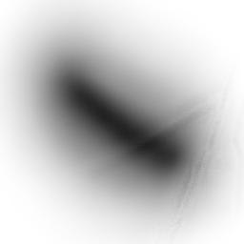
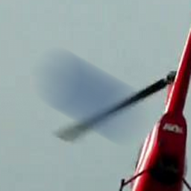
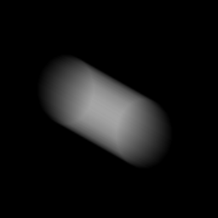
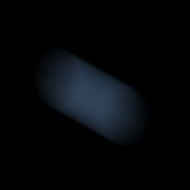


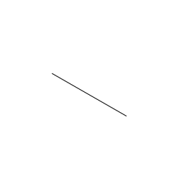
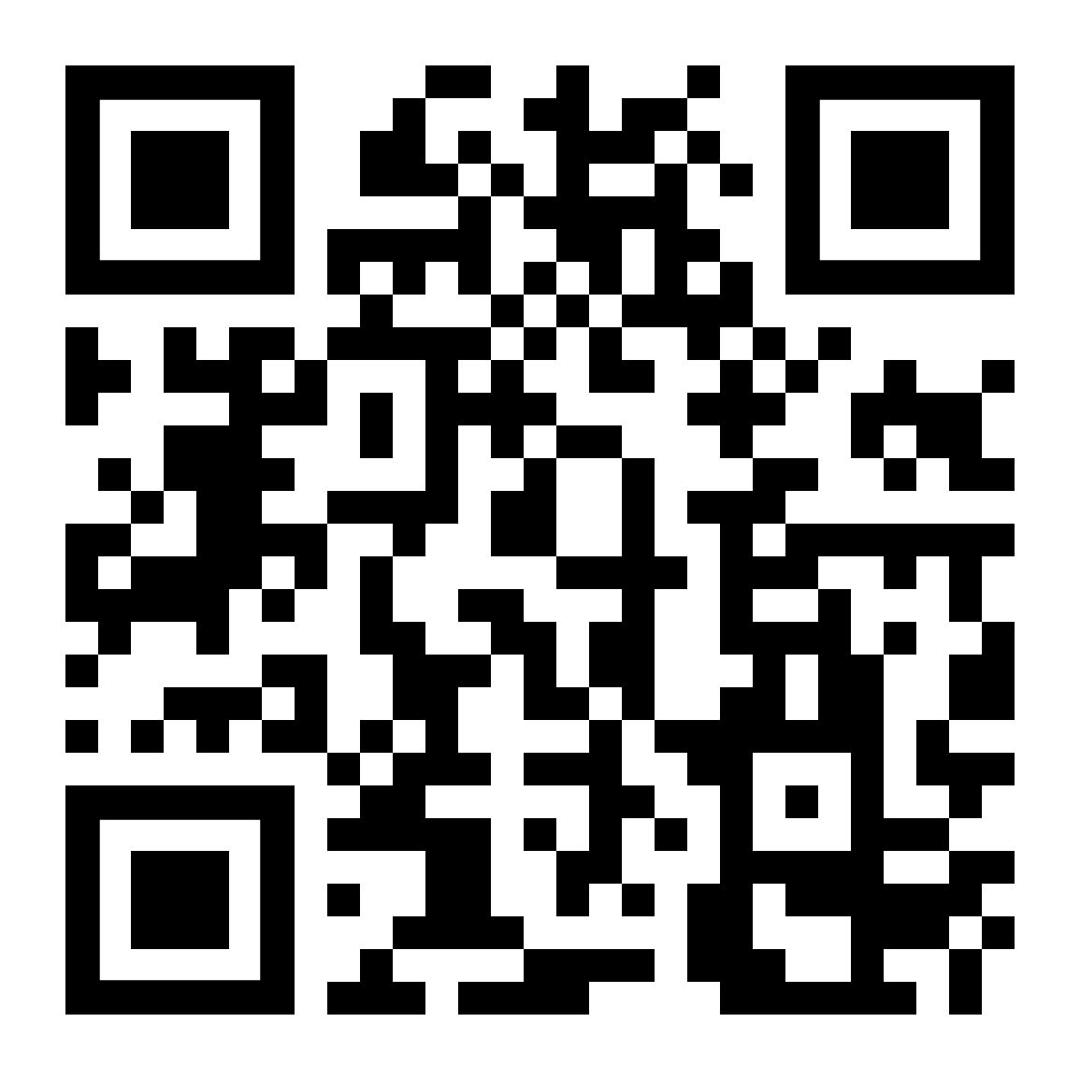
FMODetect: Robust Detection of Fast Moving Objects Denys Rozumnyi^{1,4}, Jiří Matas⁴, Filip Šroubek², Marc Pollefeys^{1,3}, Martin R. Oswald¹ ¹Department of Computer Science, ETH Zurich ³Microsoft Mixed Reality and AI Zurich Lab ²UTIA, Czech Academy of Sciences ⁴Visual Recognition Group, Czech Technical University in Prague
Introduction:
Definition: Fast Moving Objects (FMOs) – objects that move over a distance larger than their size within the camera exposure time.
Inputs:
image I with potentially several objects moving fast and appearing blurred,
background B without the object.
Task: detect all FMOs, estimate their trajectories (H), deblur their appearance (F,M). Model:
Contribution: the first learned approach for FMO detection and deblurring.
Detection examples:
The problem of detecting and tracking FMOs has been unnoticed by the research community, and such objects are not present in standard tracking datasets:
FMO retrieval on YouTube videos by FMODetect in real-time:
Method:
Step one (detection): the network detects all FMOs in the scene using a truncated distance field (TDF) to object trajectory.
Step two (matting): solve the matting problem that separates the background from the input image.
Trained on a new synthetic dataset.
Generalizes well to unseen and more difficult real-world data.
Step three (deblurring): sharp appearance (F,M) estimation. We propose a novel energy minimization-based deblurring.
FMODetect steps one and two:
Trajectories are overlaid on the input image.
False positives in TDF are usually rejected by the decision decoder.
Experiments:
Trajectory estimation,
compared to previous
methods such as [TbD]
and [TbD-NC] and the
ground truth from the
high-speed camera:
The proposed detection and trajectory estimation method is much faster (runs in real-time) and outperforms the previous methods:
In terms of deblurring quality, the reconstructed object is sharper:
Detection Network
Component
analysis
FMO 1
Matting & fitting network
Image
256
.
.
.
.
.
.
.
.
128
256
128
64
TDF
FMO N
Background
16
64
32
16
Matting & fitting network
Matting & fitting network
Matting decoder
a)
Matting
Deblurring
Detection Network
If FMO
b)
256
256
128
c)
128
64
FC
FMO? (Yes/No)
16
64
32
16
Decision decoder
Fitting decoder
Parametric Curve
Conclusion:
The first learning-based, real-time, approach for FMO detection.
Compared to the previous methods, FMODetect is simpler, does not require extensive parameter tuning, and works with the same settings for a wide range of scenarios.
Code is on GitHub: https://github.com/rozumden/FMODetect
References:
[TbD] Kotera et al. Intra-frame Object Tracking by Deblatting, ICCV VOT 2019
[TbD-NC] Rozumnyi et al. Non-Causal Tracking by Deblatting, GCPR 2019
[FMO] Rozumnyi et al. The World of Fast Moving Objects, CVPR 2017

Slide 2

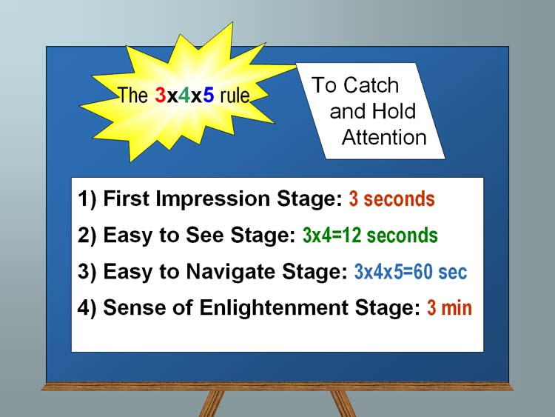
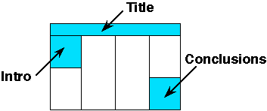
FMODetect: Robust Detection of Fast Moving Objects Denys Rozumnyi^{1,4}, Jiří Matas⁴, Filip Šroubek², Marc Pollefeys^{1,3}, Martin R. Oswald¹ ¹Department of Computer Science, ETH Zurich ³Microsoft Mixed Reality and AI Zurich Lab ²UTIA, Czech Academy of Sciences ⁴Visual Recognition Group, Czech Technical University in Prague
Introduction:
ICCV'21 will be virtual, but we are still providing the physical poster template as a rough guide
Keep in mind that most people will be viewing this poster on a computer screen
This approximate geometry should allow you to print it as a poster later, print it in landscape format on a smaller page, or use it for other purposes within your institution.
Ideally you want to keep it very readable: this is not your paper, it is a poster. 32pt here is good for most text:
Sub-bullets are 28 here (56 final)
Don’t use smaller than 24pt in this template
Insert plenty of graphics and any math you need
When inserting graphics or equations, keep the resolution high. If you can see blocking artifacts at 400% magnification in PowerPoint, consider finding better graphics. This is an example of BAD/LOW RES GRAPHICS
Leave enough margin for pushpin and remember many big plotters cannot get within .5” of the actual paper edge.
You are free to use colored backgrounds and such but they generally reduce readability.
You are free to use what ever fonts you like.
San Serif fonts like Arial are more readable from a distance,
Serif fonts like times may look more consistent with your mathematics
Section 2 (layout):
The poster should use photos, figures, and tables to tell the story of the study. For clarity, present the information in a sequence that is easy to follow.
There is often way too much text in a poster - there definitely is in this template! Posters primarily are visual presentations; the text should support the graphics. Look critically at the layout. Some poster 'experts' suggest that if there is about 20-25% text, 40-45% graphics and 30-40% empty space, you are doing well.
Section 3:
Include more figures than are in the paper so you can talk to them. Include things that are not in the paper and then encourage them to read the paper. Don’t try to just put all the paper here.
If it looks like a cut/paste of the paper, people skip that poster since they can read the papers after the conference. Many people find it better to spend time talking with poster presenters that have more to offer than just redoing the paper content paper in big fonts.
People will likely have already seen your posted video, so the poster can serve as a talking point for you.
Summary/Conclusion
Summarize your contributions
Summarize your results (if applicable)
You an add in links to additional videos, code, or project website (or QR code)

